Slide 1


Cybersecurity
Research Proposal Determine the different techniques to reduce cyberbullying and evaluate their effectiveness

Slide 2
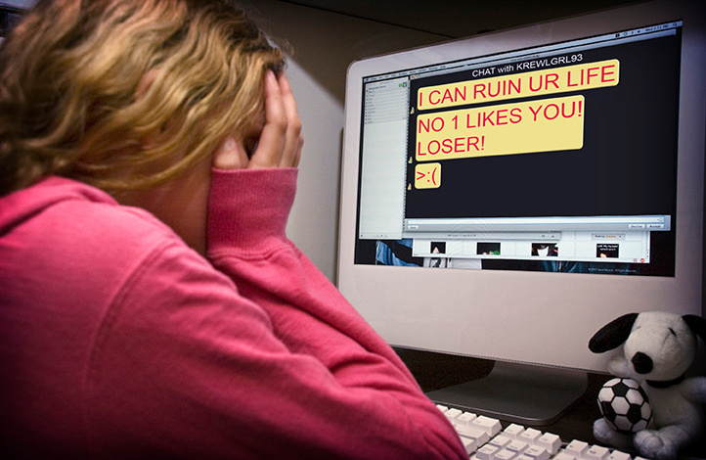
Cyberbullying
Use of digital and technological forms of communication to
Harass
Humiliate
Intimidate
Threaten (Frensch & Mulyadi, 2018)
Notes:
Cyberbullying refers to using digital and technological communication to harass, humiliate, intimidate, or threaten people (Frensch & Mulyadi, 2018). It can happen in several different ways and can involve many different types of technology: emailing, texting, instant messaging and social media sites such as Facebook or Twitter (Gaffney et al., 2019). Distinct from traditional bullying such as physical assaults or taunts; cyberbullying involves the use of more subtle technologies to attack one's target. This can mean harassing someone on social networking sites, spreading rumors through email and other electronic means, or even creating a fake account on someone's social media profile (Harasgama & Rathnayaka, 2021).

Slide 3
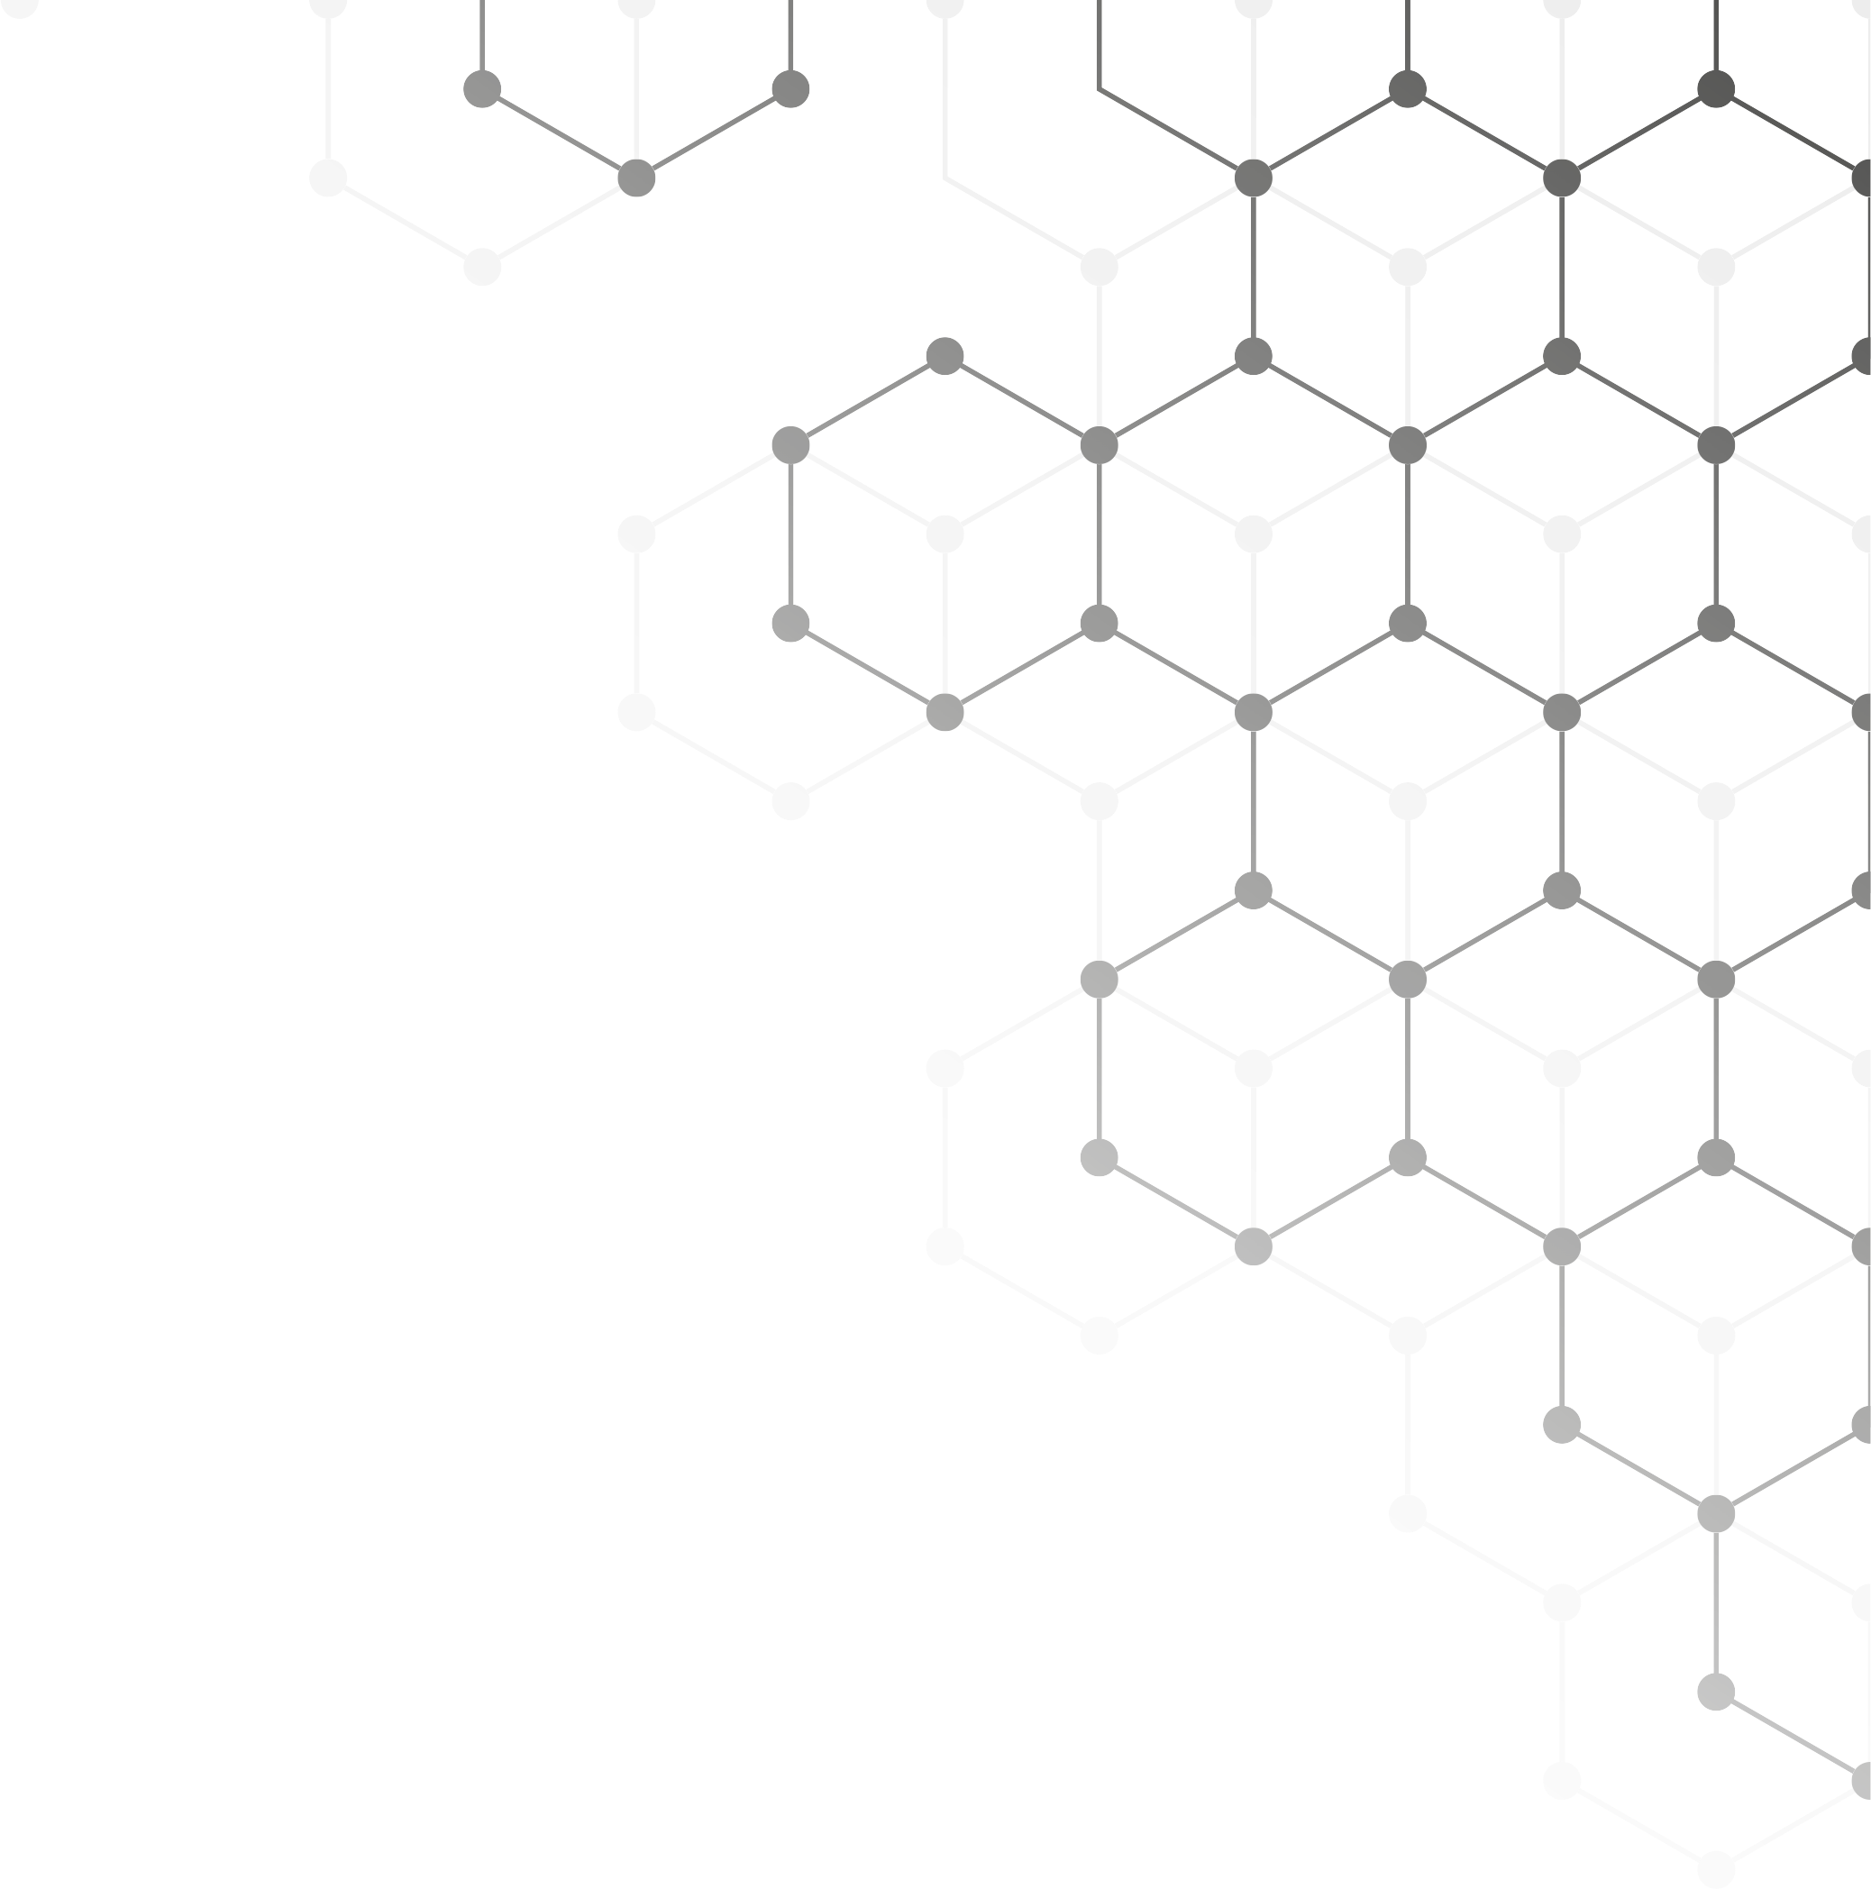
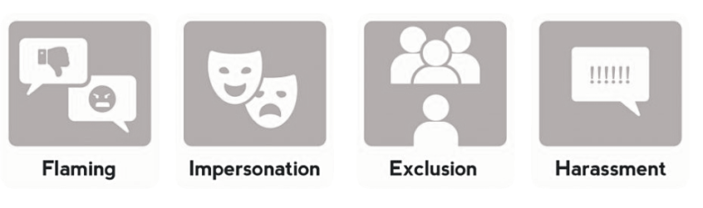
Forms of Cyberbullying
(Ansary, 2020)
(Smokowski & Evans, 2019)
(Sezer & Tuncer, 2021)
Gafffney et al., 2019)
Notes:
Cyberbullying can happen in different forms. Flaming refers to posting disparaging, insulting, rude or mean comments online (Ansary, 2020). Impersonation, which refers to using fake accounts to harass someone (Smokowski & Evans, 2019). Exclusion refers to using technology to isolate an individual (Sezer & Tuncer, 2021). Harassment is any action that tries to cause another person emotional distress; this includes threatening behavior, stalking and cyberstalking (Gaffney et al., 2019).

Slide 4
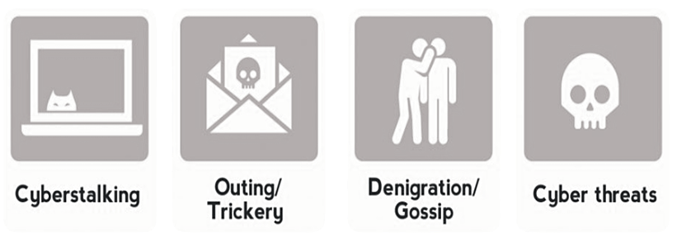
Forms of Cyberbullying Continued
(Tazzo et al., 2019)
Gafffney et al., 2019)
(Ansary, 2020)
Notes:
Cyberstalking is another common form of cyberbullying (Tozzo et al., 2022). It is a form of digital aggression where person A (the stalker) tries to intimidate and silence a particular target, such as a friend or family member. Outing refers to spreading personal information about someone online through social networks, email, text messages or social media sites (Ansary, 2020). Denigration as a form of cyberbullying refers to spreading false information about another person that results in that person becoming mistrusted in society. Lastly, cyber threats are made in through digital technologies, such as email, text and instant messaging apps (Gaffney et al., 2019).

Slide 5





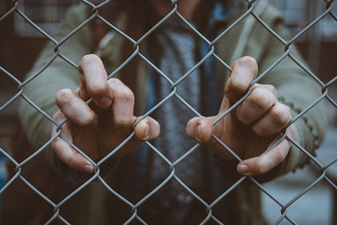
Repercussions Associated with Cyberbullying
Emotional degradation
Insecurity
Low self-esteem
Difficulty achieving goals
(Ortega et al., 2019)
(Ansary, 2020)
(Sezer & Tuncer , 2021)
Notes:
Cyberbullying in children is especially harmful for development and as a result, it can seriously affect a person's emotional well-being and lead to mental health issues such as depression and anxiety (Ortega et al., 2019). Cyberbullying can cause children to feel unsafe in their environment, making it difficult for them to go to school, participate in extracurricular activities, or seek help from an adult who could help them (Ansary, 2020). It may also lead to feelings of insecurity and low self-esteem, leading to depression, anxiety, and suicidal thoughts. Victims of cyberbullying might want to transfer schools or move away from where they live (Sezer & Tunçer, 2021).

Slide 6



RESEARCH QUESTION
Which existing policies and strategies have been found to be most effective in reducing cyberbullying and why?
Notes:
The research question is, "Which existing policies and strategies have been found to be most effective in reducing cyberbullying and why?" Through this study, one is expected to gain an understanding of cyberbullying, its causes, effects as well as factors that drive a person to become a cyberbully. This will involve the analysis of the legal aspects and policies on cyberbullying in several countries. In addition to this, the study will help in understanding what victims of cyberbullying have to say about their experience and how they are effected. The study is expected to provide effective ways of addressing the issue.

Slide 7

Aims and
Objectives
This study will aim at determining the different techniques that may be employed in reducing cyberbullying.
01
02
03
04
05
Overview of existing policies
Determination of the
effectiveness of the policies
Limitations of
existing policies
Strategies for the
existing policies
Features are effective
Notes:
Aims and Objectives
This study will aim at determining the different techniques that may be employed in reducing cyberbullying. The study will be aimed at fulfilling the following objectives:
1. Provide an overview of the main policies implemented to reduce cyberbullying.
2. Examine which policies are most effective in reducing cyberbullying and why.
3. Understand what has been noted as the limitations of existing policies in reducing cyberbullying, as well as how to overcome these challenges.
4. Examine other strategies for dealing with cyberbullying and how they can be implemented.
5. Examine what features are necessary for an effective policy.

Slide 8

(Choi & Park, 2021)
Person’s history
Literature Review
Access to technology
(Cortazar et al., 2021)
Gender and age
(Helfrich et al., 2020)
Risk Factors of Cyberbullying
Peer influence
Notes:
There are several risk factors that may contribute to one being more prone to cyberbullying. Risk factors include a person's history, access to technology, gender and race, as well as peer influence. A person's history refers to a person's past experiences, such as if he/she has been involved in bullying in the past (Choi & Park, 2021). According to Buils et al. (2020), a person who was bullied before is more likely to bullying others. A person with a history of mental health issues and substance abuse may be more likely to bully someone (Cortazar et al., 2021). An increasing number of people have access to high-speed internet (Kutok et al., 2021). With this increase in technology comes the increased use and accessibility of digital media such as social networking sites and email (Zhu et al., 2021). According to Vivolo et al. (2021), females are more likely than males to engage in cyberbullying and are equally more likely to become victims (Helfrich et al., 2020). People between 5 and 20 years are more likely to engage in cyberbullying behavior than older individuals. Lastly, peer influence refers to a person's friends and peers. This is through either direct or indirect influence as well as the way one views their peers and how they will be perceived by them (Choi & Park, 2021).

Slide 9
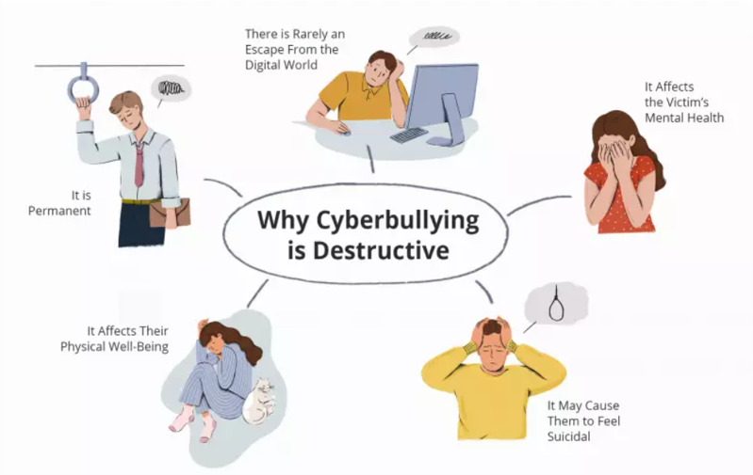
PHYSICAL EFFECTS
OF CYBERBULLYING
(Zhu et al., 2021)
1
Gastrointestinal issues
(Hekfrich et al., 2021)
2
Disordered eating
(Polanin et al., 2021)
3
Sleep disturbances
Notes:
Alarmingly cyberbullying can be felt physically, this could include gastrointestinal issues, eating and sleep disorders (Zhu et al., 2021). In recent years, it has been found that cyberbullying can cause similar symptoms to one being bullied at school. These symptoms include upset stomach and eating disorders where victims indulge in food or starve (Helfrich et al., 2021). According to Polanin et al. (2021), sleep disturbances are also linked with cyberbullying. About 1 in 5 children reports having sleep disturbances due to their experiences with cyberbullying before age 18. Another study found that children who had suffered from cyberbullying experience sleep disturbances and nightmares that were like those experienced by victims of physical bullying at school (Zagorscak et al., 2019).

Slide 10


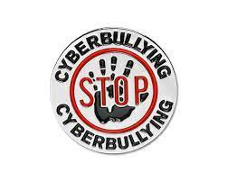





EXISTING
STRATEGIES
01
02
03
NET NANNY
PARENTAL CONTROLS
THE BADGE SYSTEM
(Field, 2018)
(Zhu et al., 2021)
(Vivolo et al., 2021)
Notes:
Strategies widely adopted in addressing cyberbullying includes installing software and apps (Field 2018). One of the most prominent is Net Nanny, which is costs approximately $20 and has an easy-to-use interface. This software monitors internet activity regularly and alert parents if inappropriate behaviors are being carried out online. The software tracks websites a child has access to and looking for potential threats or dangers. Another strategy often used to combat cyberbullying includes parental controls, which require a parent or guardian to set up a password with every Internet account utilized by them (Zhu et al., 2021). This password is used to control access on the internet and will prevent a child from accessing inappropriate content. Alternatively, another software allows parents to block access to inappropriate websites or webpages based on a ‘badge system’ (Vivolo et al., 2021). A child's profile of educational skills, achievements, and interests are used to help the parents determine which sites or webpages should or should not be blocked. Although this approach has been successful in most cases, it has also led to issues where parents have blocked their children from using social networking and as a result, the child has felt socially excluded (Polanin et al., 2016).

Slide 11




METHODOLOGY
QUALITATIVE RESEARCH
Peer reviewed journals
Existing policies
Legal cases
Notes:
The study will make use of a mixed-method approach. Primary and Secondary research along with Qualitative and Quantitative research. The secondary research, will include the use of literature reviews and the analysis of studies focused on cyberbullying. The primary research will entail interview sessions which will be performed on victims of cyberbullying. A review of legal cases will also indicate where cyberbullying is most prevalent. A quantitative analysis will also use data from multiple data sets. A review of existing legal policies will provide insight into how various countries have addressed the issue.

Slide 12
METHODOLOGY
QUANTITATIVE RESEARCH
Questionnaires
Interviews
Sample size
40 participants selected through random sampling.
Notes:
Quantitative data is usually investigated through means of statistical analysis. The study will involve the issuance of questionnaires and the performance of interviews with 30 participants who have been victims of cyberbullying in the past, 15 who have been cyberbullies in the past, and 15 who are related to victims of cyberbullying. In addition to these 30 participants, ten control participants will partake in interviews which will shed light on non-cyberbullying related issues such as parenting styles, awareness of legal regulations and policies and whether they have been affected by cyberbullying. Random sampling will be used to obtain the sample of 30 participants in this study. The participants will include younger persons between 5 and 20 years selected through an online survey on Facebook. The participants will be of different ages, gender, and geographical locations. As well as being from various backgrounds such as various nations and educational levels. The sampling procedure will be well planned and selected based on the statistical information gathered from previous studies which have been carried out to obtain a statistically significant sample size for this study.

Slide 13


SPSS Software
Data Analysis
Thematic Analysis
Notes:
The collected data will be analyzed using the statistical software Statistical Package for the Social Sciences (SPSS). The data will be analyzed both qualitatively and quantitatively. A primary analysis will be performed on quantitative data, while a secondary analysis will be carried out on qualitative data. Thematic analysis will be used for qualitative data, while descriptive statistics will be used for quantitative data. The qualitative analysis will reveal underlying themes and patterns to gain a full understanding of the collected information. The quantitative analysis will provide a description of the frequency and magnitude of cyberbullying as well as a comparison of this phenomenon with other forms of bullying that have been found to exist.

Slide 14

ETHICAL CONSIDERATIONS & Expected Outcome
Consent letter
Anonymity and confidentiality
Zero racial prejudice
Freedom of exiting the study
Notes:
All participants will be required to sign a formal letter of consent prior to data collection. All participants will be guaranteed anonymity and confidentiality. The participants' identity in this study will not be disclosed. The participants will not be identified based on their sex, race, age, or location. Participants' names will be assigned a number to remain anonymous (Cortaza et al., 2021). The identity of the interviewers will be concealed, as well. All participants involved in this study will be informed of the risks and potential benefits of participation and will be advised to contact the researcher if they have any questions or concerns. This ensures that all participants will be given a choice to participate in this study without any unnecessary pressure or need to become involved. The participants will be allowed to withdraw at any point in this study, and their anonymity will still be guaranteed. Also, participants will not be required to answer any questions they feel uncomfortable answering.

Slide 15




Artefacts
Questionnaires
Interviews
Interview transcripts
Focus group discussions
Notes:
Some of the artefacts that will be created for the study include questionnaires, interviews, interview transcripts, and focus group discussions with participants and family members who have been affected by cyberbullying. Each questionnaire will be assigned to a different participant and will be completed later. The questionnaires will be handed over to each participant, either by hand or via email. This helps maintain anonymity as well as confidentiality by ensuring that each participant does not have the chance to identify any of the other participants involved in this study. The focus group discussions and interviews with family members and victims of cyberbullying will be conducted via telephone, internet or Skype. These interviews will be conducted with a maximum of 10 participants at a time. Each interview will last for 60 minutes to allow the researcher to gather as much information from the participants as possible.

Slide 16
Timeline
TASK | TIME
Identify research area | 1week
Formulate research question and methods | 1week
Writing research proposal | 2weeks
Literature review | 1 week
Data collection | 3weeks
Data analysis | 2weeks
First draft | 1week
Second draft | 1week
Final draft | 2 weeks
Dissertation due | 2 weeks

Slide 17

REFERENCES
Ansary, N. S. (2020). Cyberbullying: Concepts, theories, and correlates informing evidence-based best practices for prevention. Aggression and violent behavior, 50, 101343.
Cortazar, N., Calvete, E., Beranuy, M., Orue, I., Echezarraga, A., León, A., ... & Fernández-González, L. (2021). Effects of a brief preventive intervention in cyberbullying and grooming in adolescents. Psychosocial intervention, 30(2), 75-84.
Field, T. (2018). Cyberbullying: A narrative review. Journal of Addiction Therapy and Research, 2(1), 10-27.
Frensh, W., & Mulyadi, M. (2018). Criminal policy on cyberbullying toward children. In E3S Web of Conferences (Vol. 52, p. 00050). EDP Sciences.
Gaffney, H., Farrington, D. P., Espelage, D. L., & Ttofi, M. M. (2019). Are cyberbullying intervention and prevention programs effective? A systematic and meta-analytical review. Aggression and violent behavior, 45, 134-153.
Harasgama, K. S., & Rathnayaka, H. B. (2021). Combatting Cyber-Bullying: An Analysis of Laws in India, Singapore, and Sri Lanka.
Helfrich, E. L., Doty, J. L., Su, Y. W., Yourell, J. L., & Gabrielli, J. (2020). Parental views on preventing and minimizing negative effects of cyberbullying. Children and Youth Services Review, 118, 105377.
Kutok, E. R., Dunsiger, S., Patena, J. V., Nugent, N. R., Riese, A., Rosen, R. K., & Ranney, M. L. (2021). A Cyberbullying Media-Based Prevention Intervention for Adolescents on Instagram: Pilot Randomized Controlled Trial. JMIR Mental Health, 8(9), e26029.
Ortega-Barón, J., Buelga, S., Ayllón, E., Martínez-Ferrer, B., & Cava, M. J. (2019). Effects of intervention program Prev@ cib on traditional bullying and cyberbullying. International journal of environmental research and public health, 16(4), 527.
Polanin, J. R., Espelage, D. L., Grotpeter, J. K., Ingram, K., Michaelson, L., Spinney, E., ... & Robinson, L. (2021). A systematic review and meta-analysis of interventions to decrease cyberbullying perpetration and victimization. Prevention Science, 1-16.
Sezer, N., & Tunçer, S. (2021). Cyberbullying hurts: the rising threat to youth in the digital age. Digital siege (ss. 179-194). Istanbul: Istanbul University Press. https://doi. org/10.26650/B/SS07, 9.
Vivolo-Kantor, A. M., Niolon, P. H., Estefan, L. F., Le, V. D., Tracy, A. J., Latzman, N. E., ... & Tharp, A. T. (2021). Middle school effects of the Dating Matters® comprehensive teen dating violence prevention model on physical violence, bullying, and cyberbullying: A cluster-randomized controlled trial. Prevention Science, 22(2), 151-161.
Zagorscak, P., Schultze‐Krumbholz, A., Heinrich, M., Wölfer, R., & Scheithauer, H. (2019). Efficacy of cyberbullying prevention on somatic symptoms—randomized controlled trial applying a reasoned action approach. Journal of Research on Adolescence, 29(4), 908-923.
Zhu, C., Huang, S., Evans, R., & Zhang, W. (2021). Cyberbullying among adolescents and children: a comprehensive review of the global situation, risk factors, and preventive measures. Frontiers in public health, 9, 634909.

Slide 18

Q&A
Any Questions?

